Slide 1


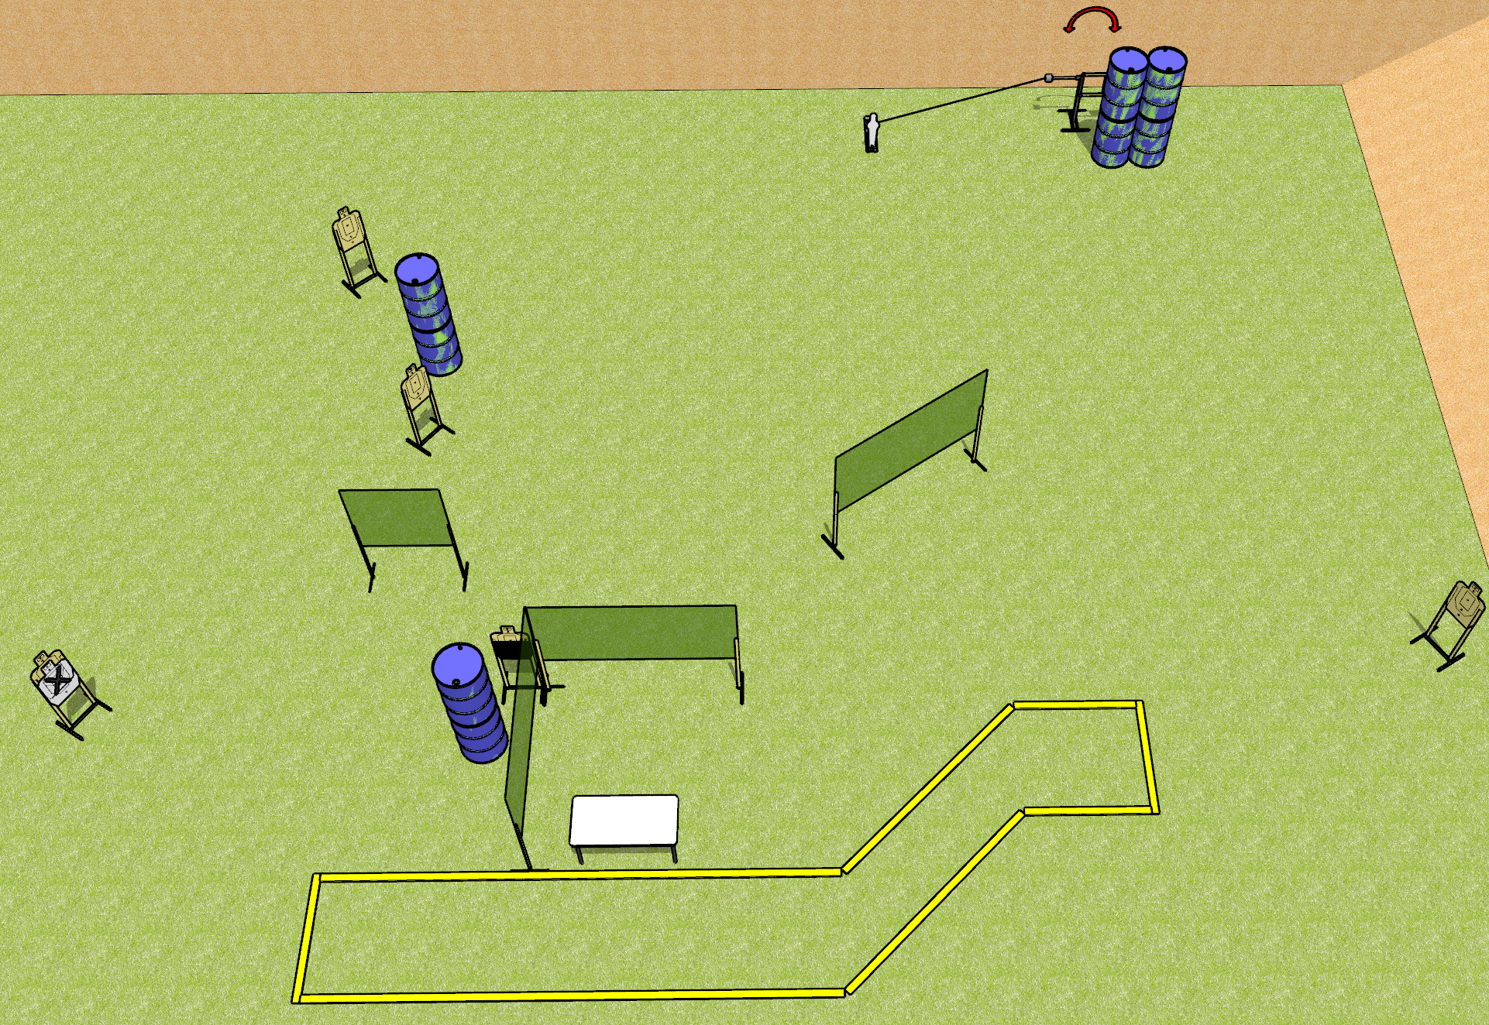
 | Dothan Gun Club – USPSA Match Shaped Up Course Designer : Drew Coleman
Round Count 13 rounds 6 USPSA 1 mini popper
Equipment List 4 medium fault lines 1 swinger + activator 1 50% 6 paper (5 + 1 NS)

Slide 2
Shaped Up
Written Stage Briefing
Shaped Up is a 13 round, 65 point, Comstock course of fire. There are 6 USPSA targets and 1 mini popper. The best 2 hits on paper will score, and steel must fall to score. The start signal is audible.
The swinger is activated by the mini popper and remains visible at rest.
Start position is behind rear fault line, completely outside the shooting area. Firearm is loaded on table, trigger guard on mark, not propped in any way.
On start signal, engage targets as they become available from within the shooting area.

